Slide 1


सजिलो Agronomy: IoT in soil study and automated irrigation for plantation and farming in Nepal ST. XAVIER’S COLLEGE, Maitighar
Final Year project by:
Anu Kadel (2674/070)
Hemanchal Joshi(2688/070) Supervisor:
Er. Rajan Karmacharya

Slide 2
INTRODUCTION
Plants are
essential for human survival
Basic entities of agriculture/agronomy
सजिलो Agronomy is an initiative for
Utilization/Optimization of water resources
An idea to blend Agronomy with technology
Simple mechanism with flexible application

Slide 3
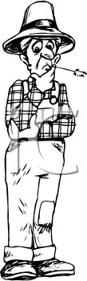

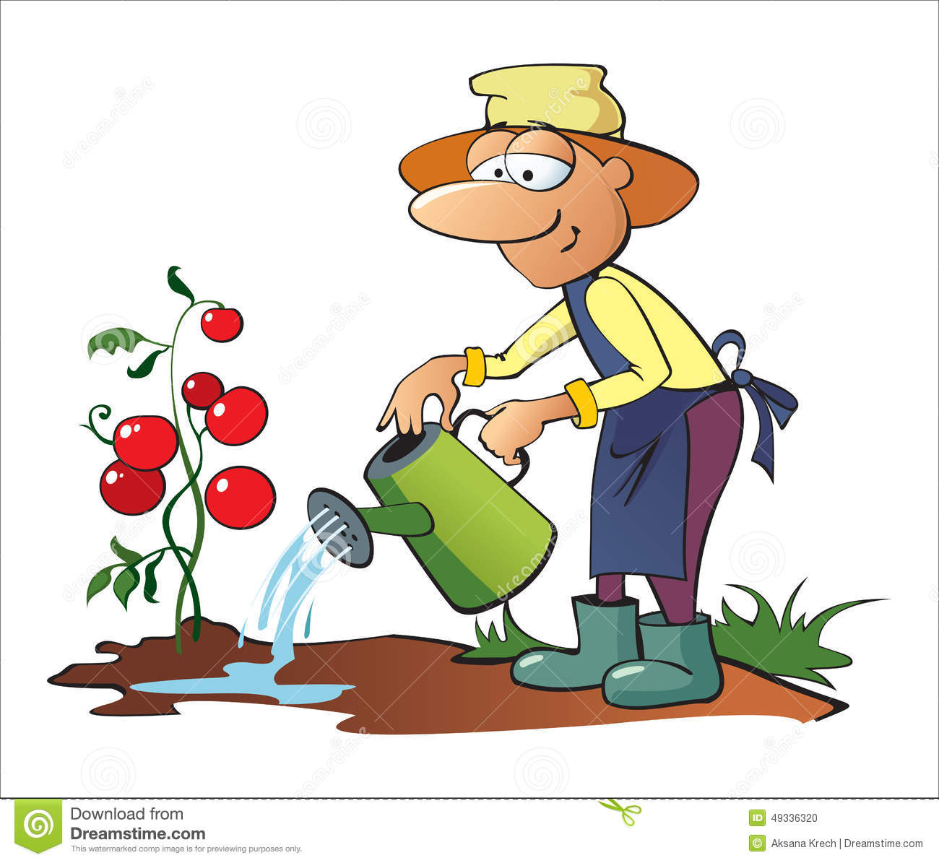
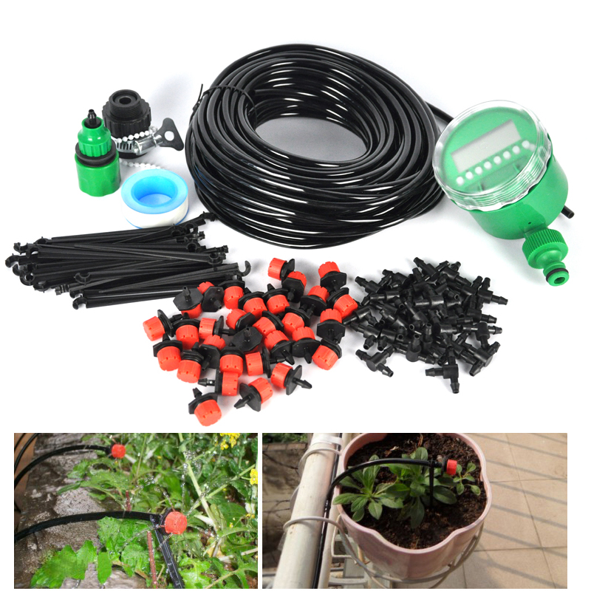
PROBLEM STATEMENTS
We haven’t used such technology before. We don’t know much about it. It is a risk to use it for the first time.
But will they grow in sandy soil? I can that search over the internet but I don’t have time.
And the tomatoes are not growing properly. Am I planting them right? Is it the soil? Is it the water?
We used something this this before but it turned out that idea was not so productive.
Oh!! It would be a lot easier if the plants could drink water themselves.
I love those flowers. Maybe I’ll plant them in my backyard.
I guess this is not a good idea.
Oh wait!! I go to work early in the morning. Who is going to water them properly?
There is so much work left. I have to hurry before the milk boils
Lack of systematic irrigation facilities.
Few know soils alter productivity
Tools and technologies for plantation and irrigation
Lack of time leads to decrease in plantation activities
Lack of knowledge of plants.
Unable to develop trust due to lack of idea
Prior unpleasant happenings

Slide 4
PROJECT OBJECTIVES
Optimize water resources
Enhance productivity
Encourage plantation
Information on soil distribution

Slide 5
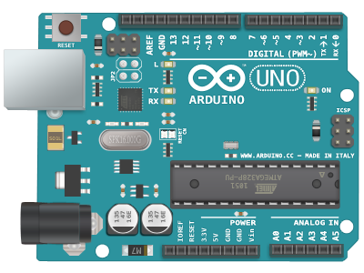


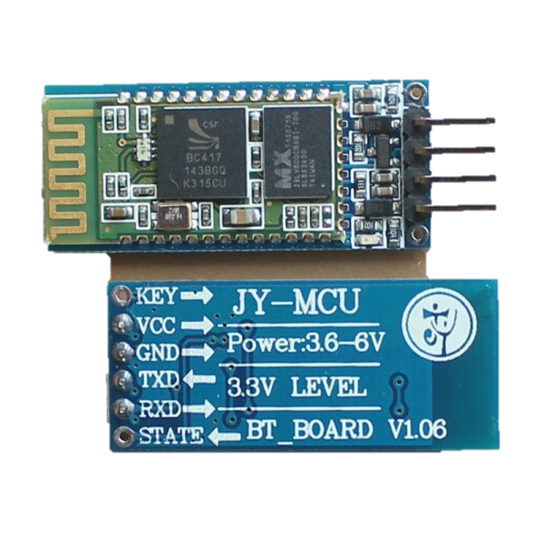
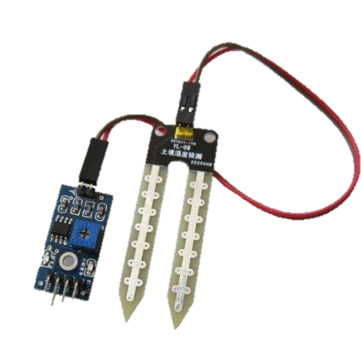
TOOLS/PLATFORMS USED
Arduino Uno
+
+
+
Bluetooth Module HC-05
+
Arduino IDE
Android Studio 2.2.3
YL -69 Moisture Sensor

Slide 6

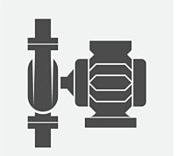


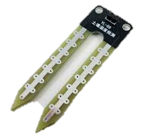


SYSTEM ARCHITECTURE
Power
Supply
Display
(Desktop)
Bluetooth
Relay
Microcontroller
(Arduino)
Water Motor
Mobile
Soil Moisture Sensor
User
(Farmer)

Slide 7
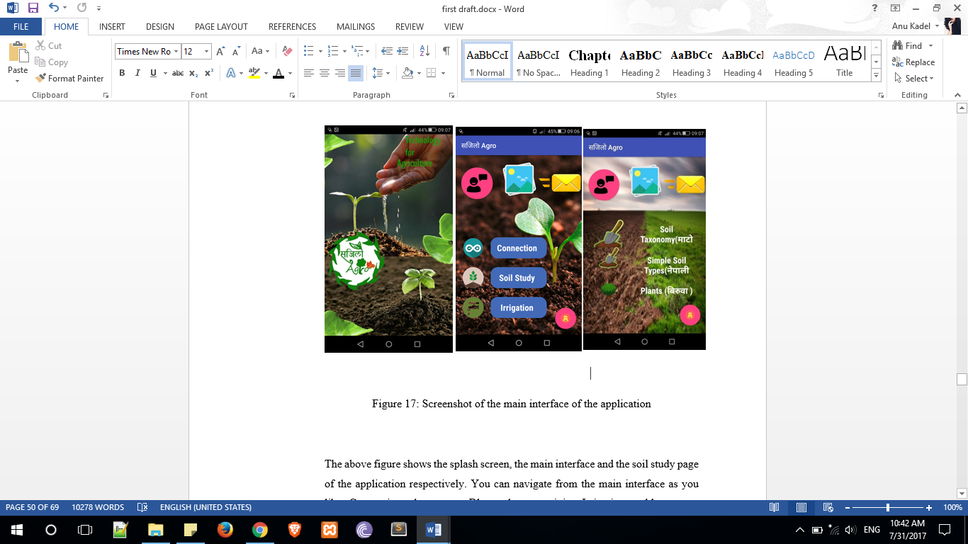
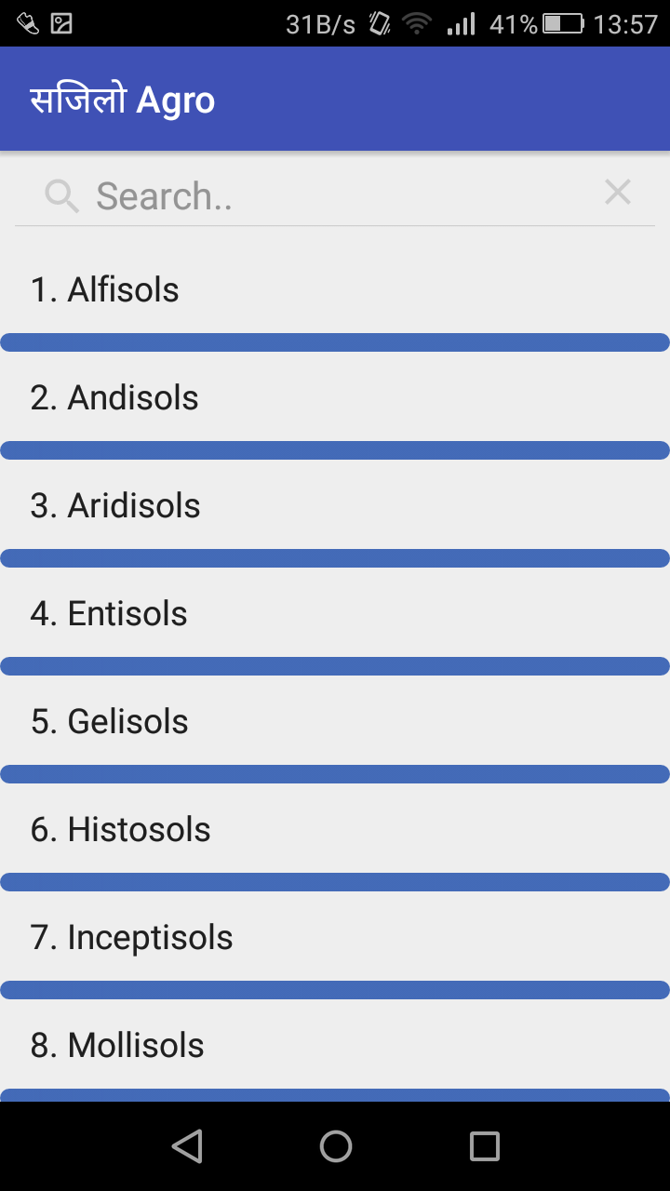
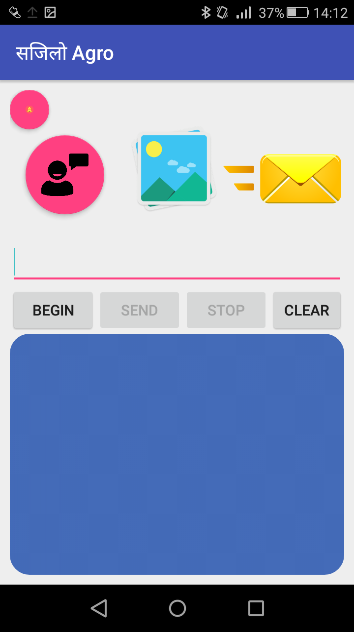
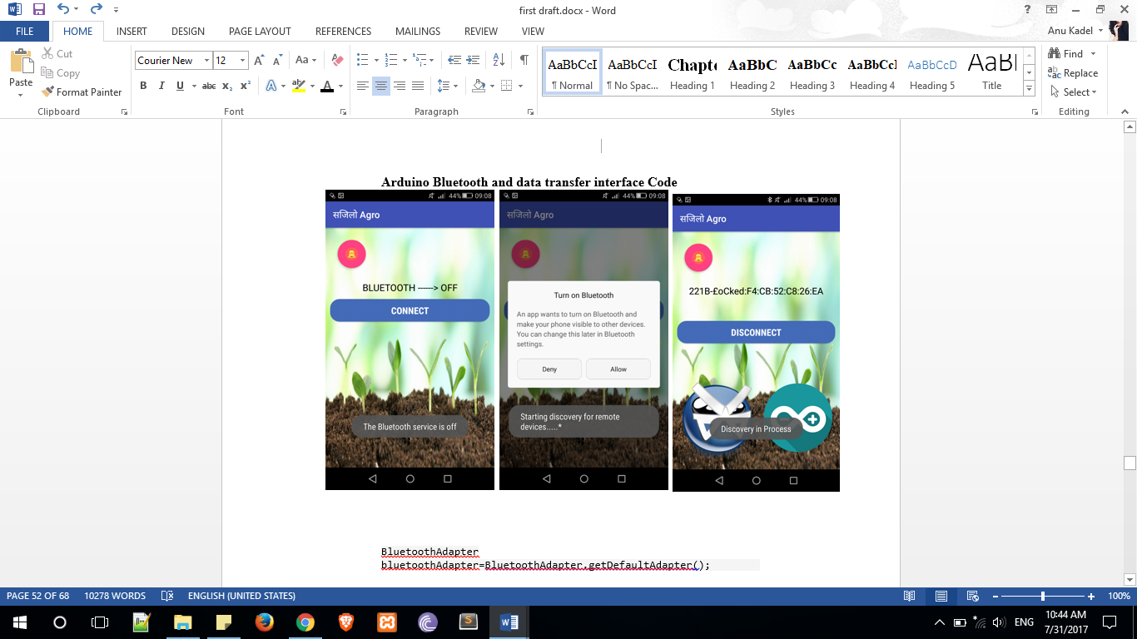
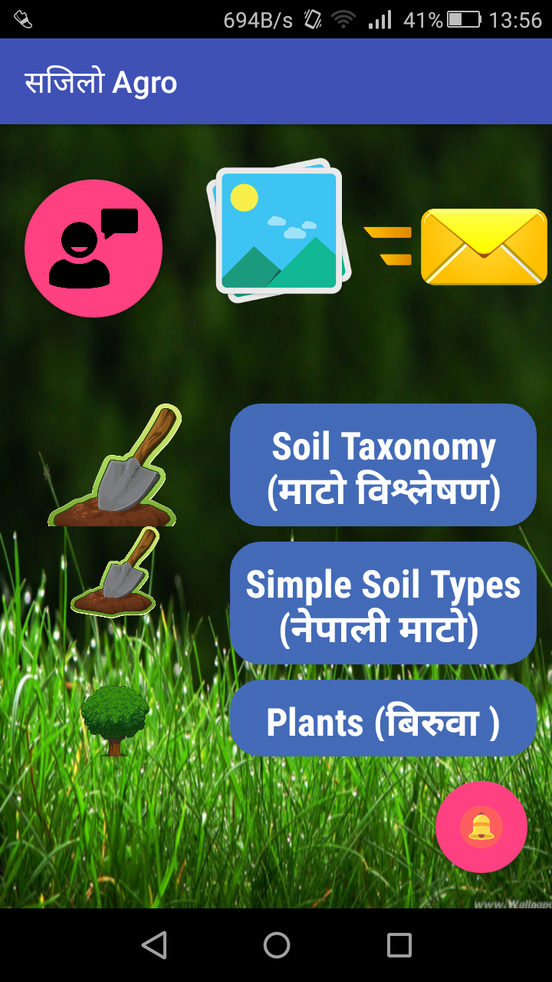

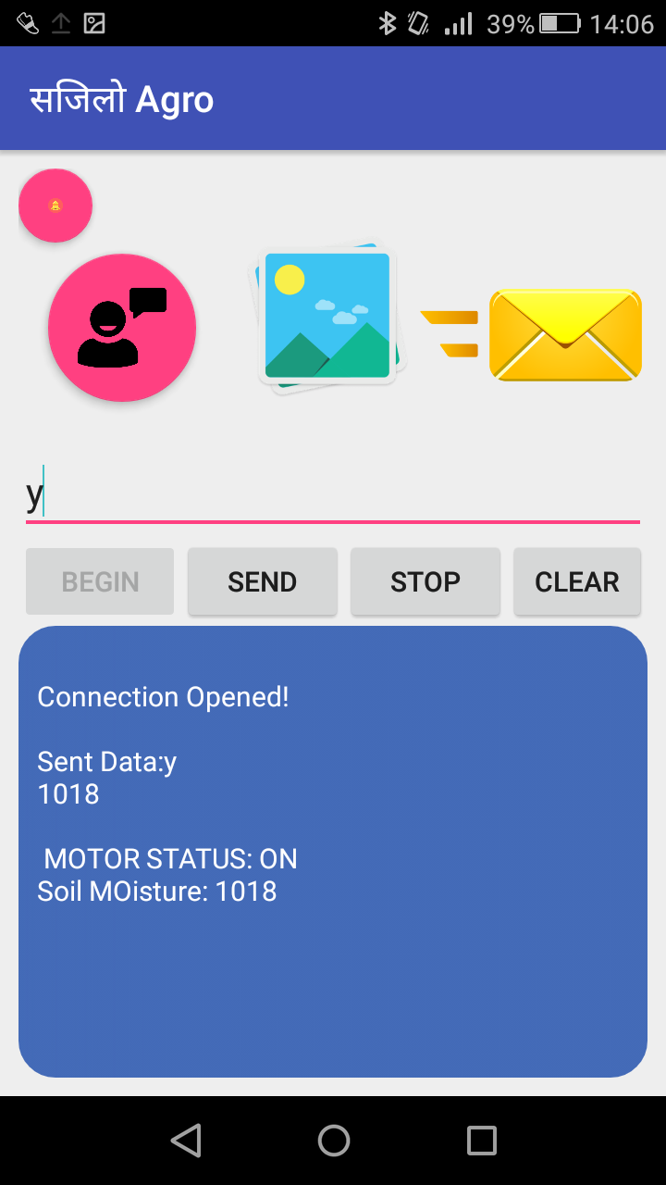

PROJECT DELIVERABLES
Working of the Application Interface

Slide 8
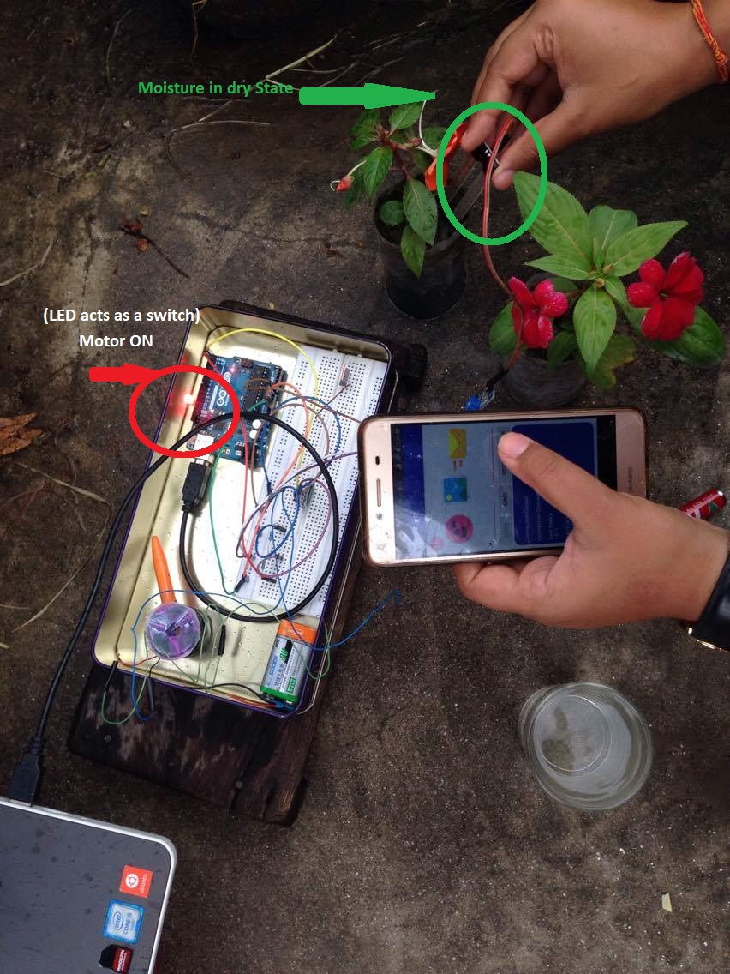
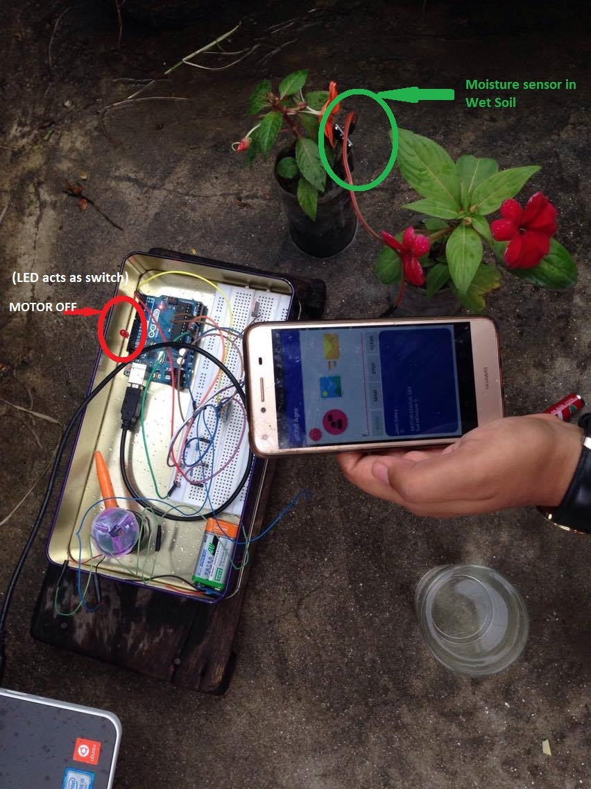
Hardware interfacing:

Slide 9
CRITICAL ANALYSIS
Project is a flexible idea emerged after thorough case study at NARC
Findings:
poorly managed irrigation facilities
reckless use of resources
minimal use of technology in agriculture
Project shows:
Automated irrigation
Soil moisture sensing (can be used for further research)
Evaluation of soil for better production
Remote Applicability (No Internet, No android devices No problem)

Slide 10
Automated irrigation systems in Nepal (just a theory) – not implemented
Research and implementation in various SAARC Nations
Project Modifications:
Addition of database
Further Research (Agriculture is a unceasing field of study)
Can use various modules:
Wifi (Urban- small scale plantation)
Bluetooth(Research)
GSM (remote areas- farming)
No modules ( Very remote areas- No telephones)
Can slowly flourish with the increment in use of technology.

Slide 11
CONCLUSION
A feasible idea in an agriculture oriented country
Developed after thorough research
Flexible and easy to implement
Blends technology and agriculture
Small as well as large scale implementation
A platform for further research (soil distribution in productivity)
Just an initiation which can be modified/ improvised

Slide 12
THANK YOU

